Slide 1
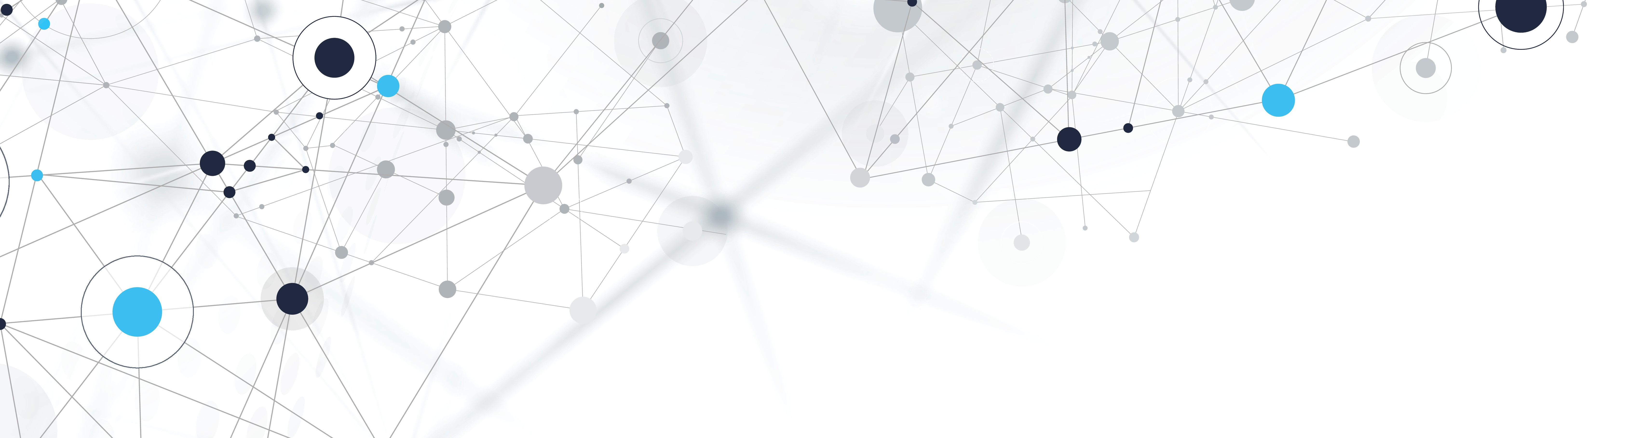
Global Activism
Eti Mayer
Final Project – NOV 2021

Slide 2
Eti mayer
Junior Data Scientist – certified DS from Bar Ilan
DS Skills: ML Models, R, Python (DS packages), SQL Server
Experience:
She Code Final Project – Global Activism
Israeli Security Agency Hackathon 2021 – DS Team Lead
Final project in the DS course – NoShow dataset

Slide 3

Global Activism
Domain Field: Global Capital Market
Main Project Purpose: Predict Activists’ Campaign Succession for an Activism Follower Fund
Data Source: SEC 13D Forms

Slide 4

What is an Activist campaign?
An activist investor is an individual or group that buys a significant stake in a public company in order to influence how the company is run, such as by obtaining seats on its board of directors. Companies that are mismanaged, have excessive costs, could be run more profitably if taken private, or have other problems the activist investor believes they can fix are often targets for activist investors

Slide 5
A person or group of persons acquire a significant ownership stake in a company (more than 5% of voting class)
Disclose the purchase on a Schedule 13D form
The share holder becomes a beneficial owner
How to Find Activists’ Campaigns?
Schedule 13D is a form that must be filed with the U.S. Securities and Exchange Commission (SEC) when a person or group acquires more than 5% of any class of a company's equity shares. There are several pieces of relevant information that must be disclosed within 10 days of the transaction. Schedule 13D is also known as a "beneficial ownership report."

Slide 6
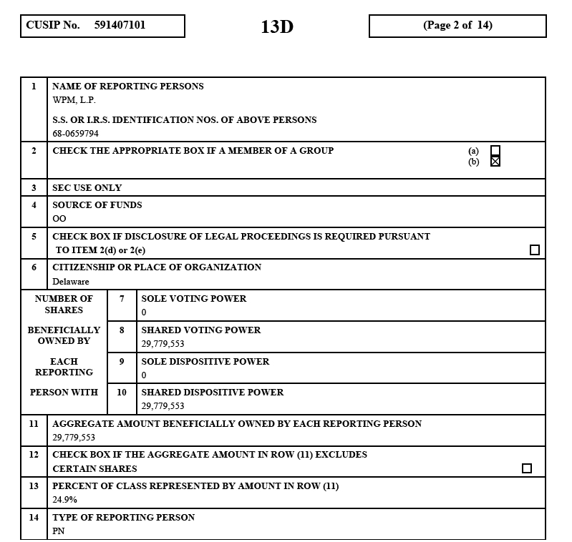
13D Form
Activist Name
Share Stake
Stake Size

